Slide 1
DATA STORYTELLING & STATISTICAL VALIDATION
Task 4 – Data Analytics Internship
ApexPlanet Software Pvt. Ltd.
Presented By:
V. Gunasekaran
B.Tech (Artificial Intelligence and Data Science)
Akshaya College of Engineering and Technology

Slide 2
Project Objective:
The objective of this project is to analyse a retail sales dataset and transform raw business data into meaningful insights using data storytelling and statistical validation techniques.
Objectives:
Analyse sales performance.
Understand customer purchasing behaviour.
Identify high-performing products and cities.
Validate findings using statistical tests.
Provide actionable business recommendations.

Slide 3
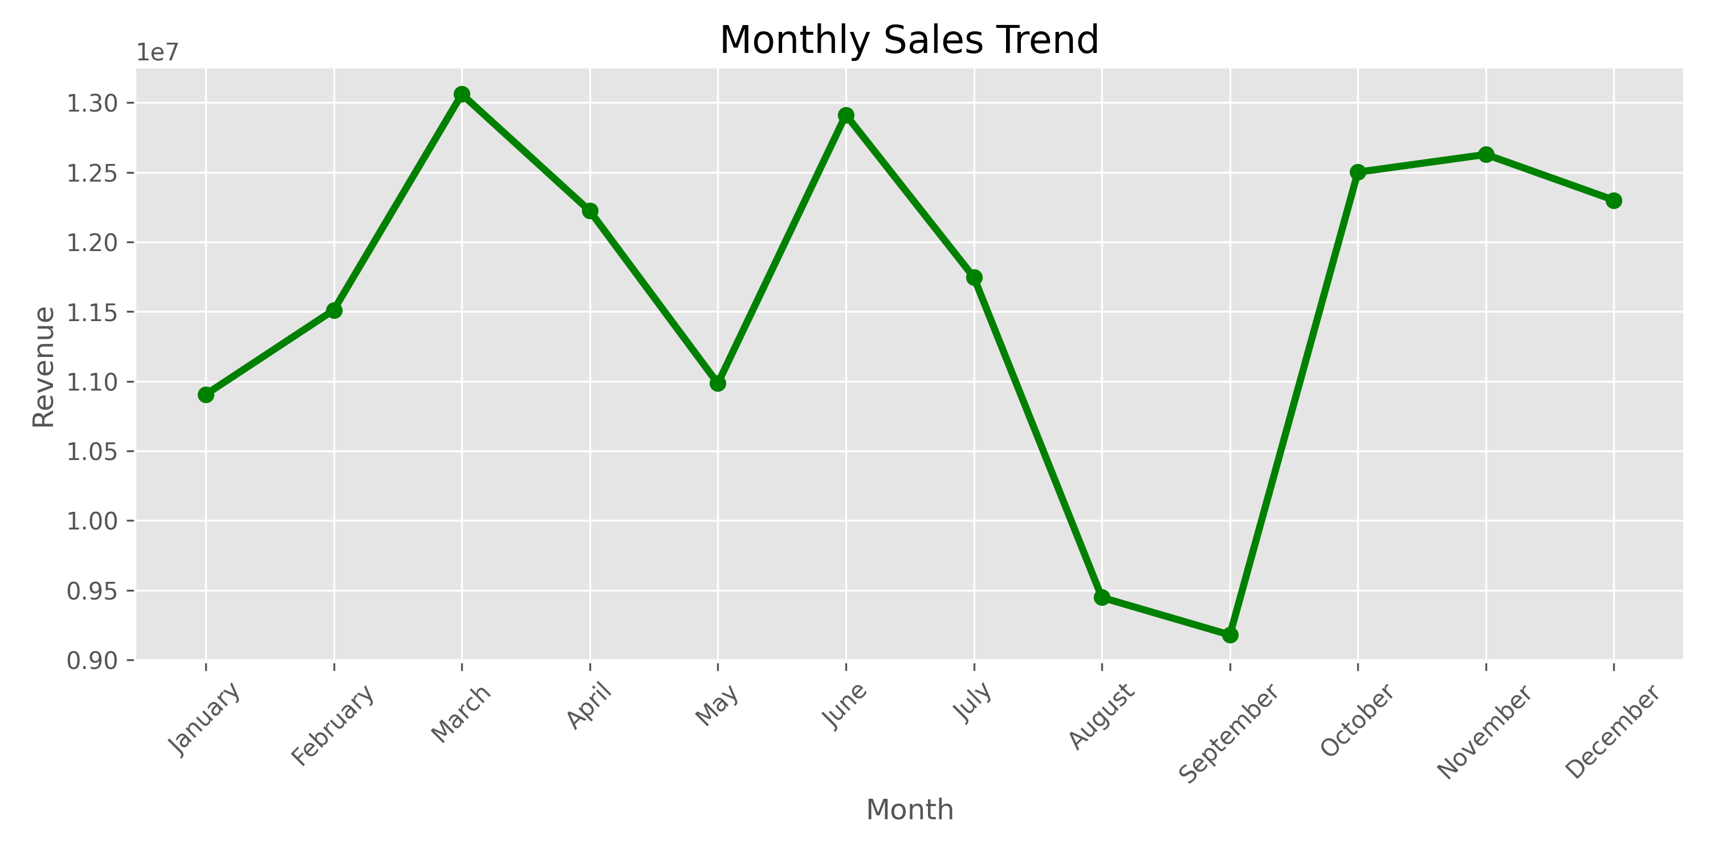
Sales Performance Analysis:
Key Findings:
Electronics generated the highest revenue.
Certain cities contributed significantly more sales.
Monthly sales showed seasonal fluctuations.
Business Insight:
Understanding these trends helps businesses improve inventory planning and marketing strategies.

Slide 4
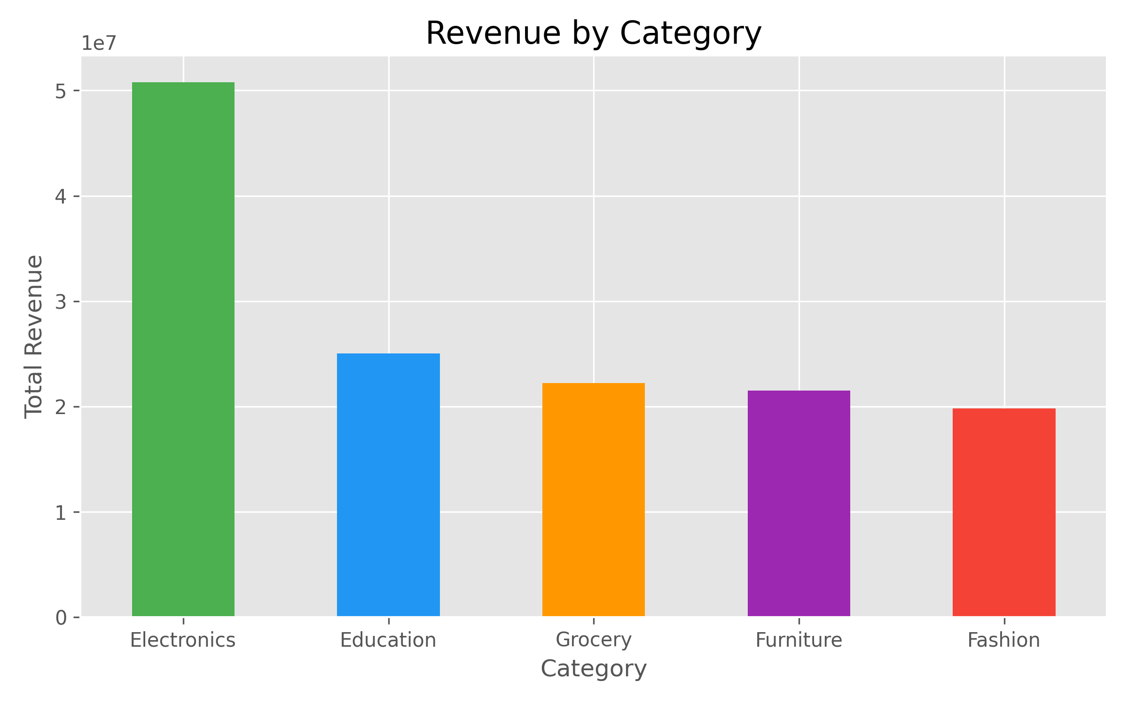
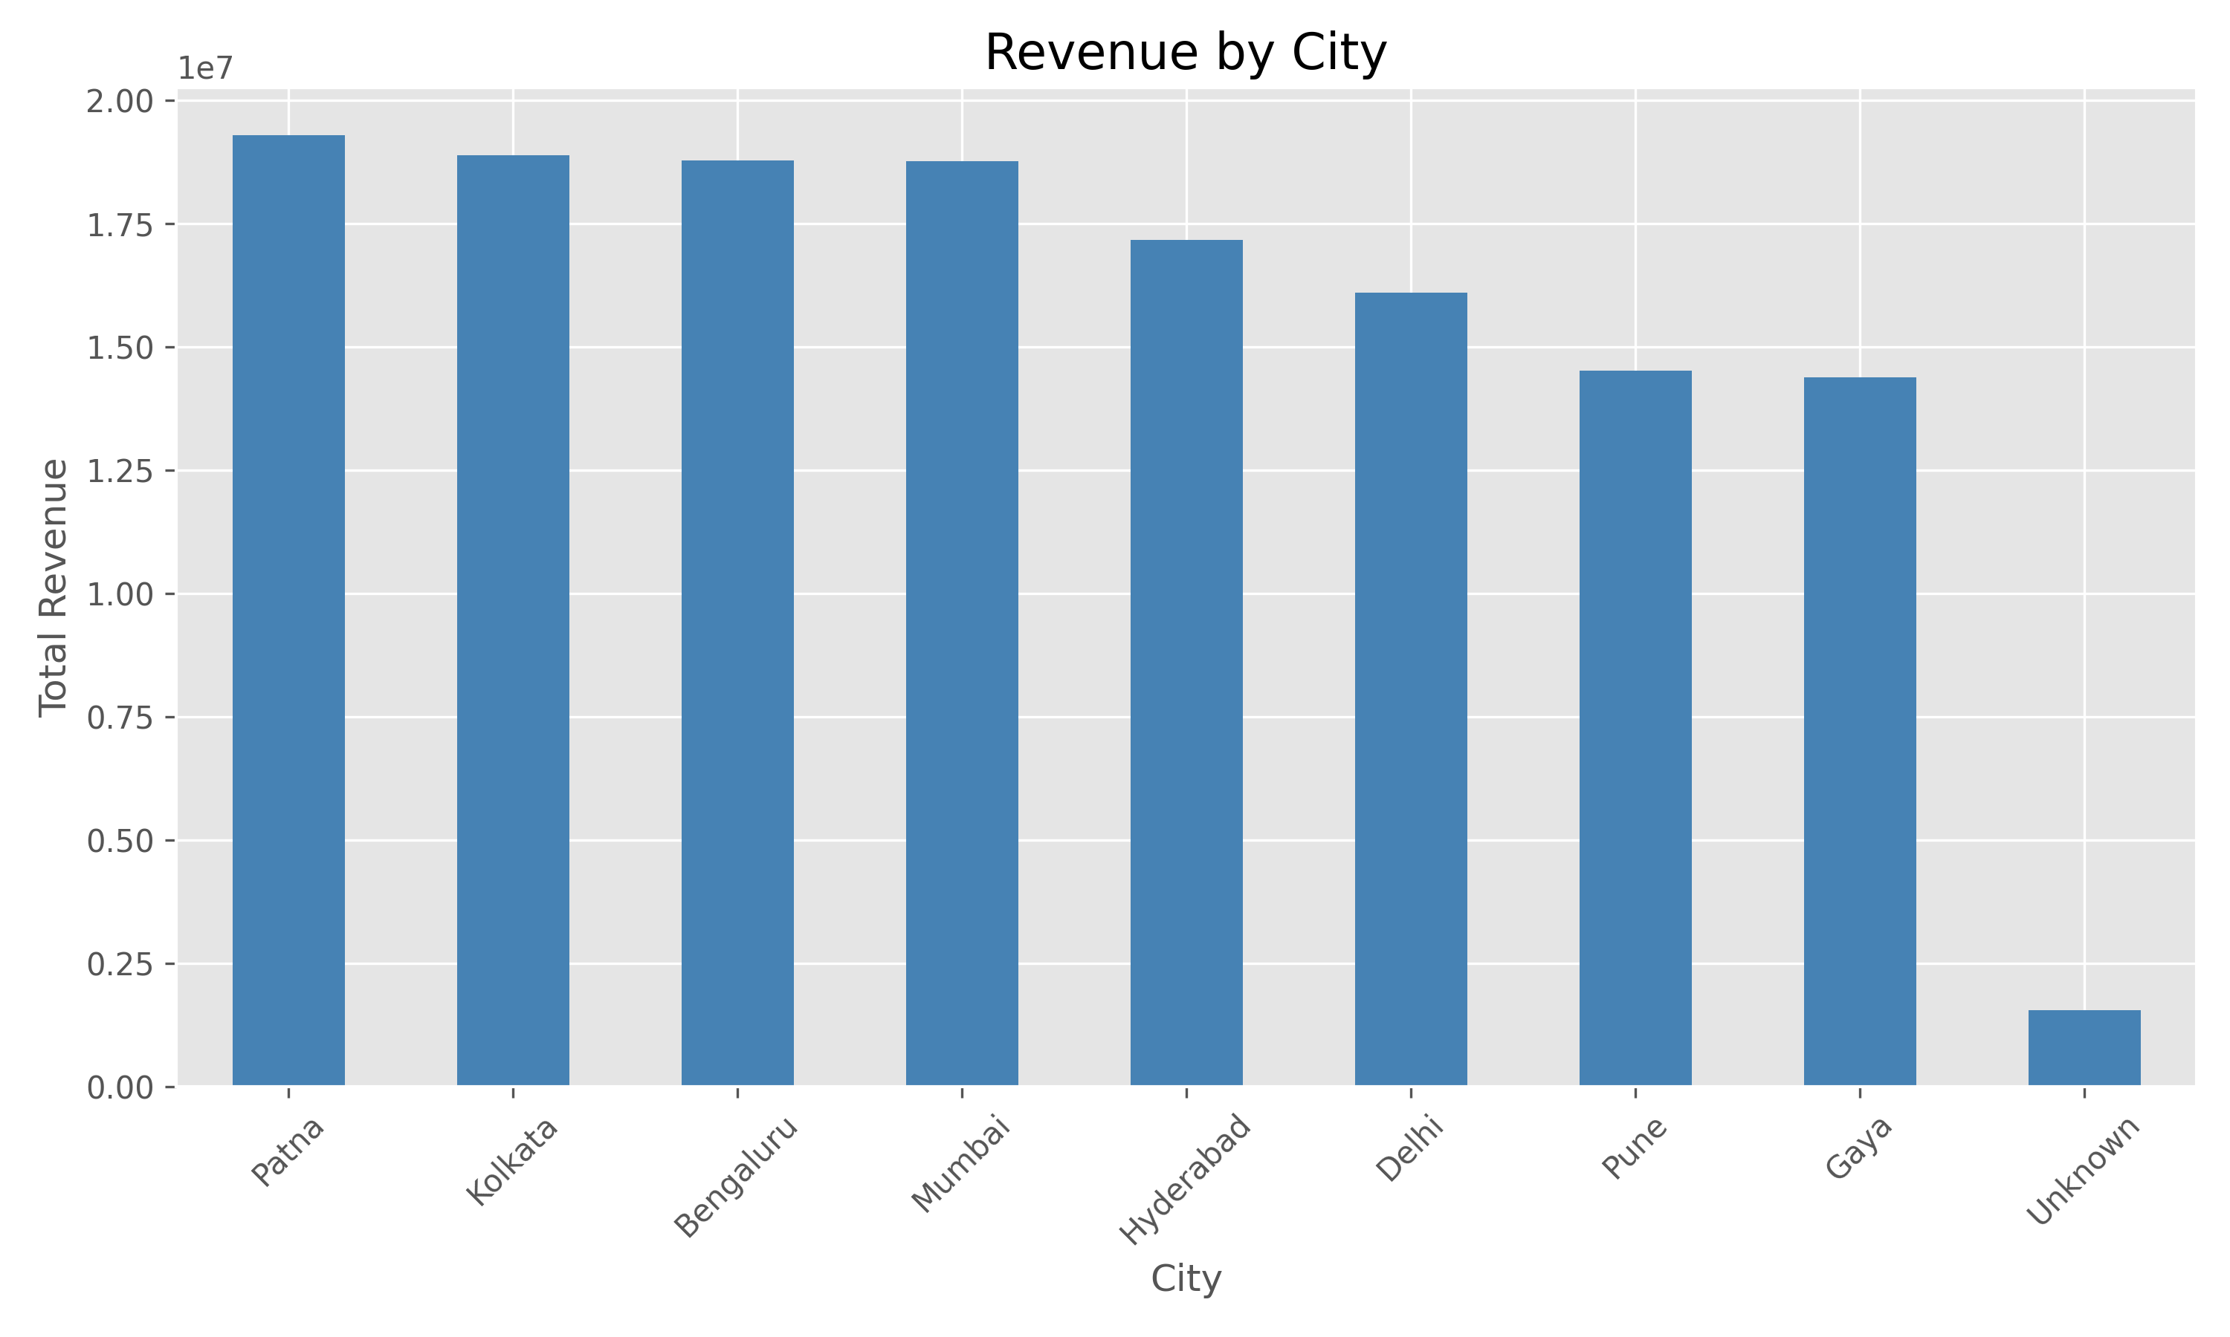

Slide 5
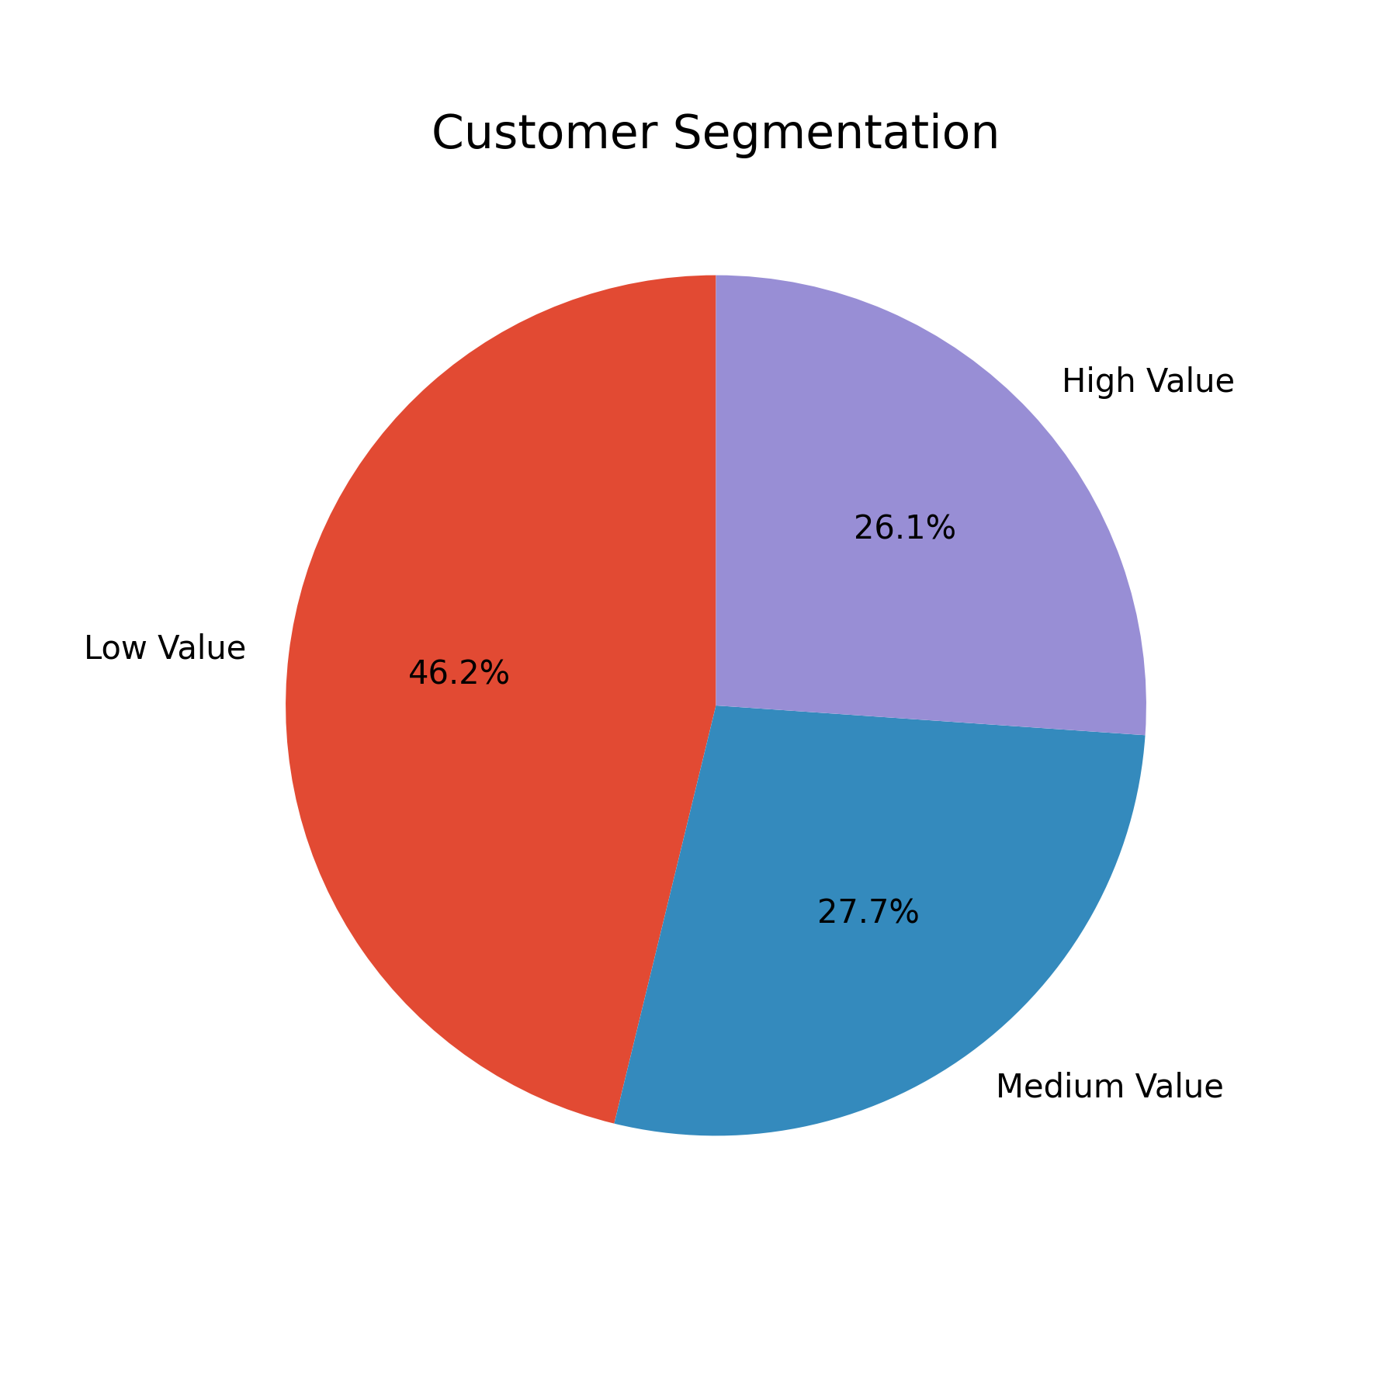
Customer Analysis:
Observations:
Most customers belong to the Low Value segment.
Customer distribution is nearly balanced across genders.
A few products contribute a large portion of the total revenue.
Business Impact:
Customer segmentation enables personalized marketing and better customer retention strategies.

Slide 6
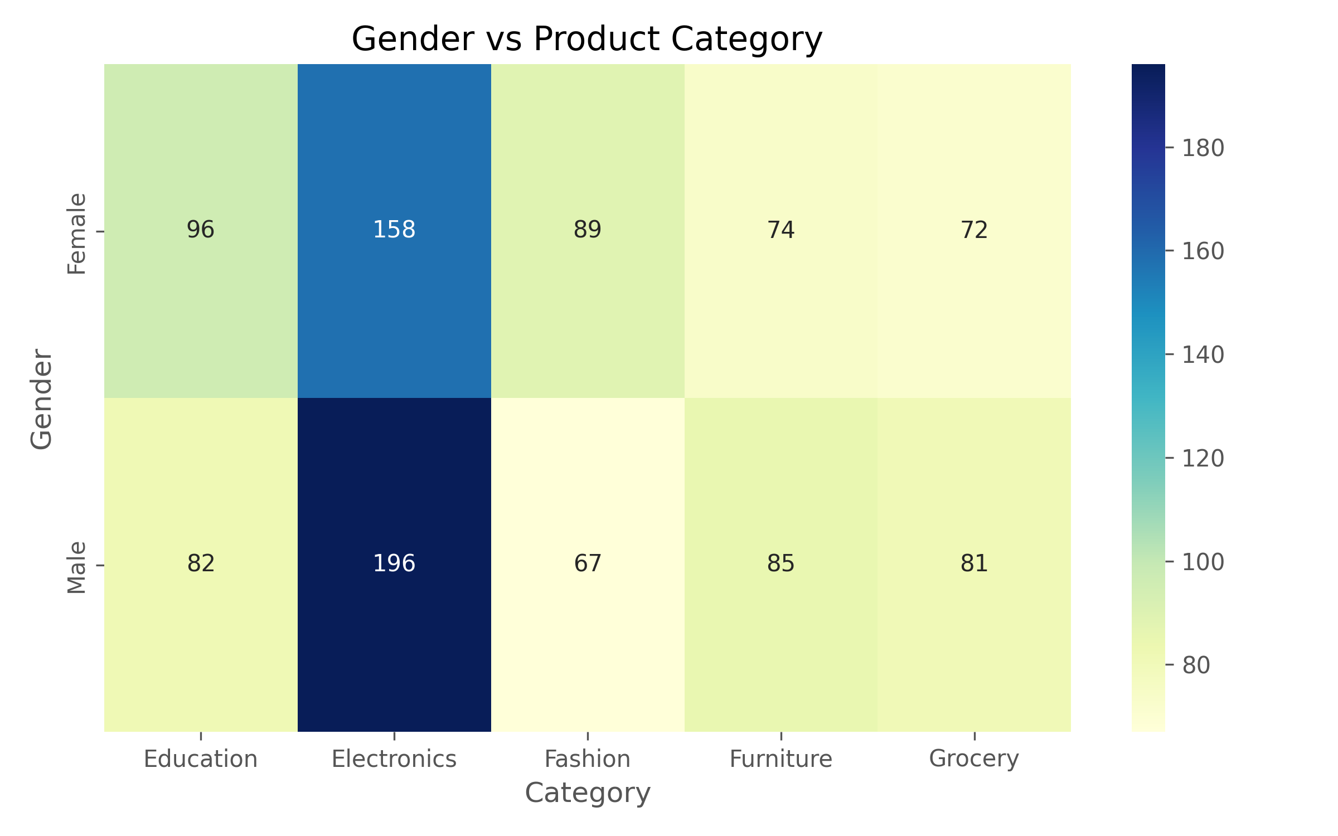
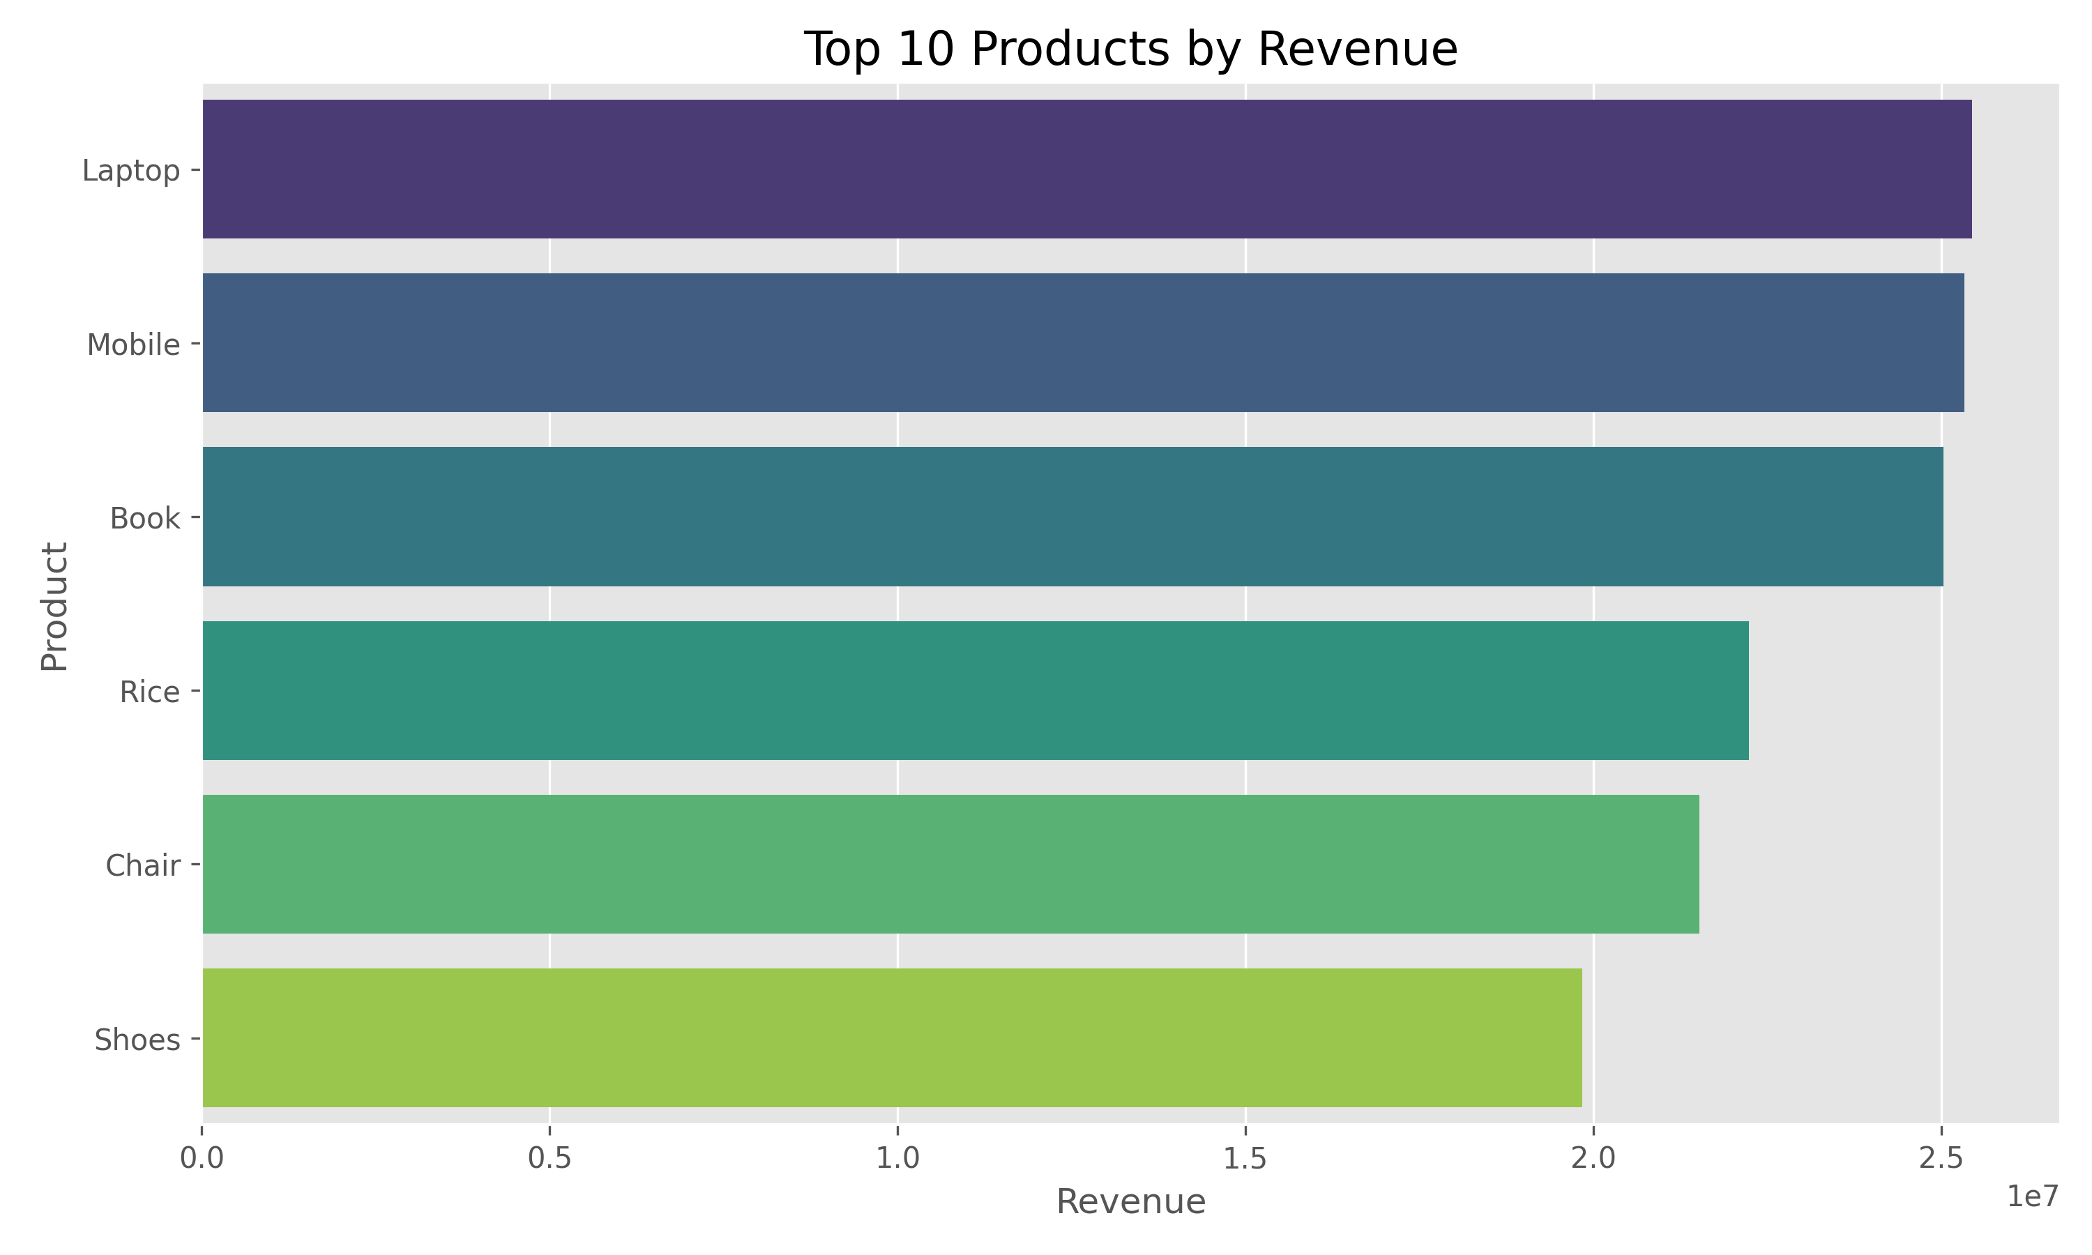

Slide 7
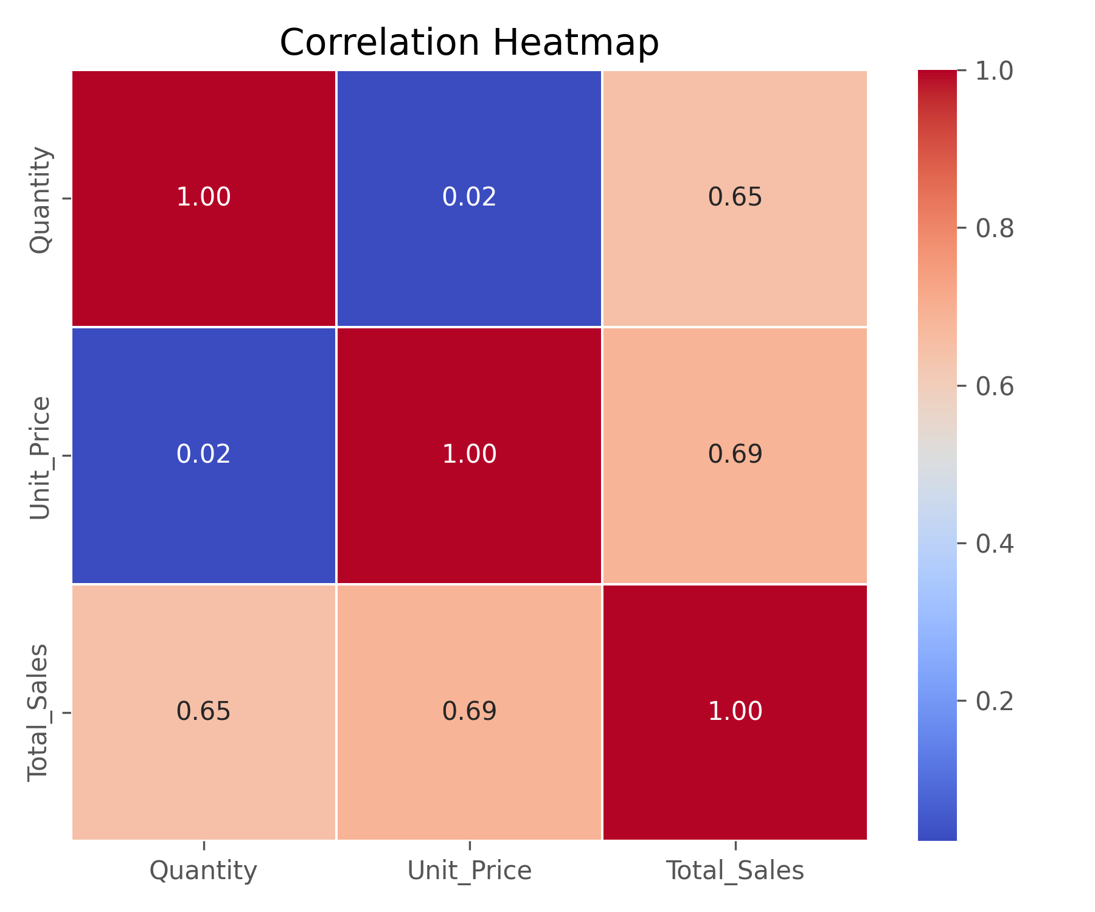
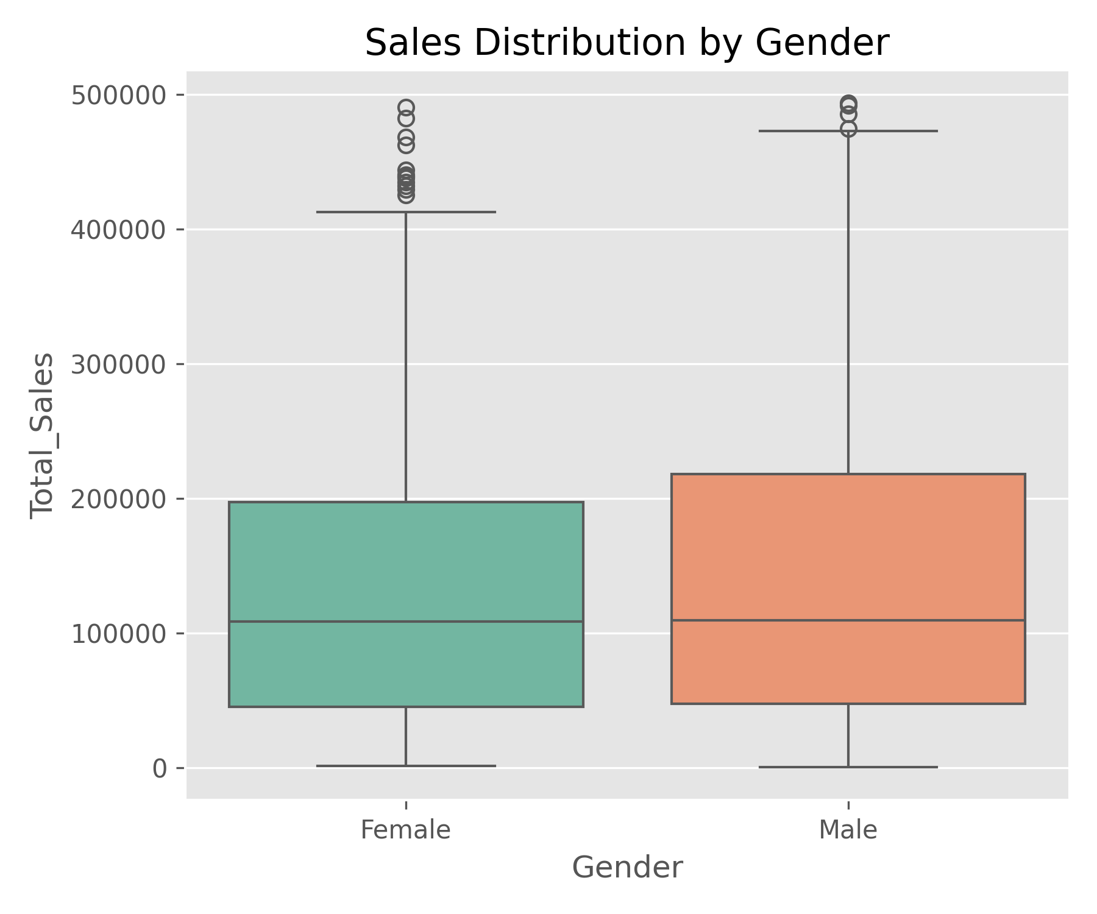

Slide 8
Business Recommendations:
Recommendations:
Based on the analysis, the following recommendations are proposed:
Increase inventory for Electronics products.
Strengthen marketing campaigns in high-performing cities.
Introduce loyalty programmes for High Value customers.
Use customer segmentation for personalized promotions.
Monitor seasonal sales trends to optimize inventory.
Continue using dashboards for regular business monitoring.
Support future business decisions with statistical validation.

Slide 9
Conclusion:
This project successfully demonstrates how data storytelling and statistical validation can transform raw sales data into meaningful business insights.
Key Achievements:
Data Cleaning
Exploratory Data Analysis
Data Storytelling
Business Visualization
Statistical Validation
Hypothesis Testing
Business Recommendations

Slide 10
Thank You
Questions & Discussion

